Slide 1
Reversi group 6

Slide 2
MiniMax Algorithms

Slide 3
Performance Problems
Disqualifications caused by timeouts
On depth limit 2
Especially on large maps
Total time: 191,6s
1

Slide 4
Solution
Heuristics evaluating move on position
How many stone does the move capture?
2

Slide 5
Improved version
Heuristics now biggest part
Rewrite heuristics
Total time: 28,1s (-85% !)
Strong performance on other maps
3

Slide 6
Measurement System

Slide 7

Architecture
DataManager
creates
.csv - file
enters
Measurement
Class
creates
4

Slide 8



Data Structure
Data bucket
Measurement
Arraylist
5

Slide 9

Data Structure
Data bucket
Measurement
Arraylist
6

Slide 10
Data Structure
Data bucket
Measurement
Arraylist
7

Slide 11



Data Structure
Data bucket
Measurement
Arraylist
8

Slide 12
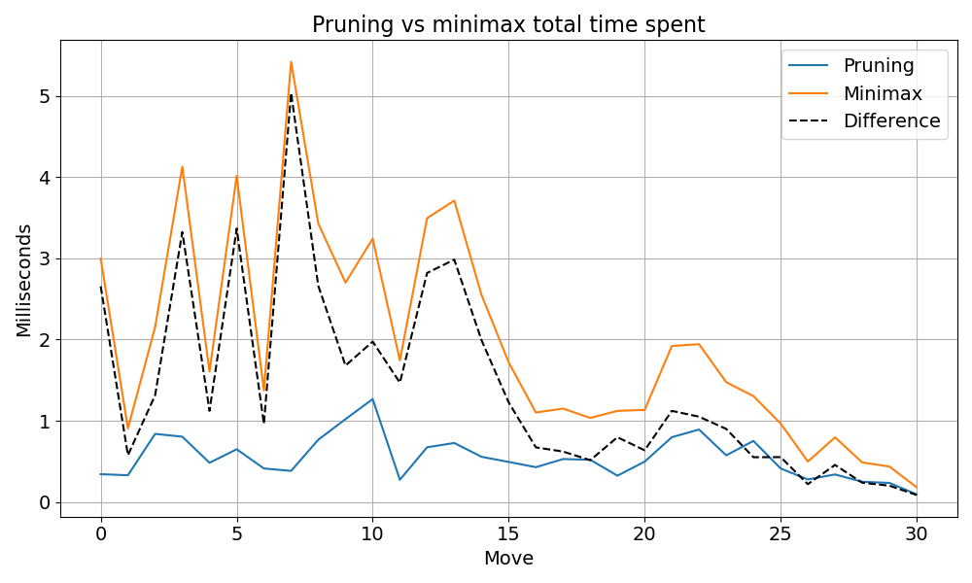
Comparison
9

Slide 13
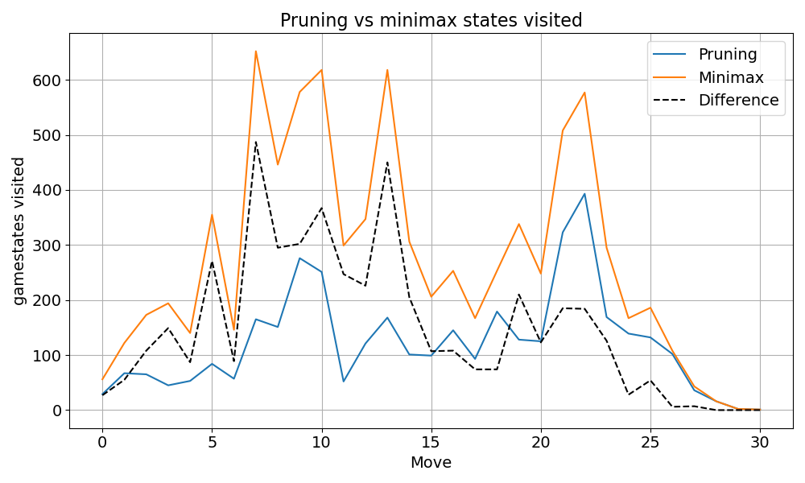
Why is pruning better?
Less states visited
Less states need computing
10

Slide 14
pruning upgrade ideas
Biased alpha beta pruning
Prune all overwrites
11

Slide 15
Dynamic Heuristics
Corner side propagating to the inside
12

